Slide 1

Welcome to Parents’ Night!
Thank you for “MAKING AN IMPACT” in your child’s education!
We will begin in a few minutes!
While you wait….
Please sign-up for a conference time/date
Please locate your child’s desk and welcome letter
FYI…Tonight’s slideshow is posted on our classroom website

Slide 2
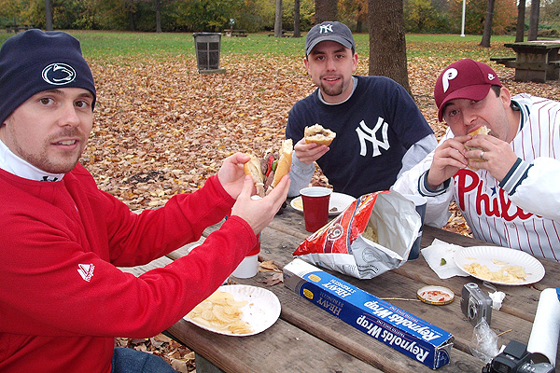
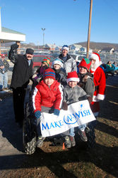

Who is Mr. Koback?
I am:
University of Pittsburgh Graduate
Penn State University Graduate (M.Ed. Educational Leadership)
Mahanoy Area School District 4th grade teacher for 2 years
Keystone Central School District 3rd and 4th grade teacher for 6 years
Quakertown Community School District 3rd grade LTS
Boyertown Area School District 2nd, 3rd, and 4th grade LTS
Coordinator of Make-A-Wish Foundation fundraisers
Father of a 6 year old son at New Hanover Elementary
Avid Sports fan ( Go Philly! Hail to the Panthers! We Are…)

Slide 3
My Classroom Philosophy…
“MAKE AN IMPACT!”
“Believe It, Achieve It!”
“RESPECT is Earned!”

Slide 4

My Classroom Management
Respect Card Policy (group and individual):
R – E – S – P – E – C – T
Disrespectful or Irresponsible behavior = Loss of a Respect Card
Must EARN back Respect Cards…NOT given!
Full RESPECT = Respect Card Committee Member
Lose all RESPECT = Loss of Privileges (Parent contact)
GES UNITY RULES
GES Behavior Clip Chart
Impact Student of the Week!!!

Slide 5
Our schedule
8:25-8:45 Student Arrival
8:45-9:00 Morning Message (Non-fiction)
9:00-10:30 Math
10:30-10:50 Recess
10:50-11:20 Lunch
11:20 – 12:00 Social Studies/Science
12:00-1:50 ELA (Reading)
1:50-2:30 Special
Schedule posted on website
2:30-2:40 Break/Snack
2:40- 3:20 WIN (What I Need)
3:20 – Dismissal

Slide 6

The Fourth Grade Reading Curriculum
READING INTENSELY !!!
Readers are AWARE that EVERYTHING counts!!!
Balanced Literacy Approach
  Daily 5, Shared Reading, Guided Reading, Independent Reading, Read Aloud
Comprehension is the Key!!!
“Road to Comprehension-ville” 9 key strategies:
  Retell, Prior Knowledge, Text Connections, Question, Clarify, Visualize, Predict, Infer, Summarize
Reading a variety of genres
  Fiction, Non-fiction, Biographies, Autobiographies, Historical Fiction, Science Fiction, Folklores, Poetry
  www.booksource.com (Leveled Book Reading Lists)

Slide 7

Reading Activities
To Do At Home:
Have your child
  Summarize what was read
  Tell the main idea of the passage/story
  Describe the setting by drawing a picture
  Identify the character’s or story’s main problem
  Write a paragraph telling what the story means to you
  Tell what the character’s point of view is
  Compare characters in the story or to another story
  Describe how the problem develops and is resolved
  Describe the feelings of the characters
  Describe how the character changes
  Reread a part of the story with expression
  Tell how the character changed from the beginning of the story to the end
  Tell how you acted like the character in the story
  Compare the setting of the story with where you live
  Tell about something in your life that this book reminds you of
  Make a list of questions to ask the author or a person described ion the passage
  Describe how the author used character names to enhance the story
  Compare this story to another story
  Tell if you would recommend this story to someone else – tell why or why not
  Tell how you would change the story
  Tell what the author had to know to write the story

Slide 8

The Fourth Grade Writing Curriculum
The Writing Rubric Domains
  Focus
  Content
  Organization
  Style
  Conventions
Types of Writing
  Narrative
  Opinion/Persuasive
  Informative/Explanatory
  Research
  www.storybird.com

Slide 9
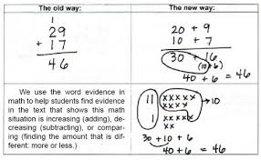

The Fourth Grade Math Curriculum
Learn Zillion (Learning Videos)
Math Stations (Small Group Rotation)
www.frontrowed.com

Slide 10

Social Studies Curriculum
History & Geography
Civics, Government, & Economics

Slide 11
Assessment Evidence
It’s a collection!!!
In Class Assignments (Engagement)
Small Group Conferring
Writing Journals/Pieces
Reading & Math District Benchmarks
(F&P, 4-Sight, Comprehensive)
Formative Assessments (Exit Tickets)
Summative Assessments

Slide 12
Standards Based Grading &
Report Cards
All daily activities are focused on Common Core Standards. These standards are broken down into many learning targets. Students are assessed daily on their progress towards demonstrating proficiency of these learning targets.
Progress is reported to you formally 4 times a year. Students can receive:
    4 = Demonstrates mastery of the learning target/standard
    3 = Proficiency demonstration of the learning target/standard
    2/1 = Not yet demonstrating mastery of the learning target/standard.
Please remember that the learning targets are year-long goals and their indicators communicate their current progress towards that goal.

Slide 13
Curriculum and
Depth of Knowledge
BASD’s curriculum is constantly evolving to remain rigorous for student achievement.
Teachers use “Depth of Knowledge” when lesson planning, creating activities and simply questioning students.
Four levels of Depth of Knowledge –
    Recall – students memorize, recite, simple answer point-blank questions
    Basic Application – perform procedures, conduct investigations, demonstrate/explain
    Strategic Thinking – analyze/investigate new information and communicate understanding (be able to explain)
    Extended Thinking – apply concepts, make connections and critique, generate or create something new with your knowledge.
Some recall and basic application might be necessary with some learning targets, but should be expanded into the strategic and extended thinking areas.

Slide 14
What is WIN?
What I Need (WIN) is 40 minutes of instructional support.
Some students receive instruction from our reading specialists, aides or other teaching professionals.
It is an opportunity for the fourth grade team to create differentiated groups to meet the diverse needs of our students.
Your child will receive extra support, more practice, or enrichment on a specified skill.

Slide 15

Homework
Study Island and/or Frontrowed websites
INTENSE Reading !!! Book Study !!!
Multiplication Practice (Math Magician website)
Students will lose a Respect Card for each missed assignment

Slide 16
Technology Resources For Home
Each student will receive a “technology form” in their binder. This contains all websites, usernames and passwords needed to access all sites.
Website | Purpose | Username | Password
Network Log On | Access netbooks
www.brainpop.com | Animated educational site for all subject areas
www.frontrowed.com | Practice math learning targets
www.studyisland.com | Practice reading, math and social studies learning targets
www.reading.ecb.org | Learn and practice reading strategies
www.sumdog.com | Practice all Math learning targets. ]\
www.storybird.com | Use illustrations to excite and spark writing pieces

Slide 17
What about the PSSAs?
“BRING IT ON!!!”
What is the PSSA?
Pennsylvania System of School Assessment
(i.e. State Tests)
When are the tests?
April 11th PSSA window opens
What do the PSSAs assess?
Mathematics, Reading, and Science achievement based on academic standards
Want more info?
Check out the Pennsylvania Department of Education website: http://www.pde.state.pa.us/

Slide 18
Communication Methods
The Koback Report
Weekly/Bi-weekly
“Top Ten Reasons Your Child Attended…”
Phone, Email, and Notes
  Excuse slip after an absence
  Parent Pick Up (please DO NOT leave a message, please send in a note or call the office)
  jkoback@boyertownasd.org
  School Phone: (610) 369-7485 ext. 5026
Homework:
Classroom Website
www.makeanimpactinclass.weebly.com

Slide 19
Other Info
Birthdays
  Only invitations that are given to the entire class will be distributed by teacher
  ***Please give at least 1 day notice for birthday treats to be brought into school.***
Parent Help – Security Clearances!!
  Class Parties – Room Mom/Dad Volunteers?
  Field Trips

Slide 20
Questions?
Don’t forget to sign up for a fall conference!
Please leave a note for your child!
Thank you for coming!
Mr. Jason Koback
jkoback@boyertownasd.org

