Slide 2
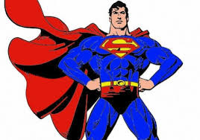
Who is the true Hero?
noun, plural heroes
1.a man or woman of distinguished courage or ability, admired for his or her brave deeds and noble qualities.
2.a person who, in the opinion of others, has heroic qualities or has performed a heroic act and is regarded as a model or ideal

Slide 3
Frank Leahy
US Army
Grandfather of Austin Leahy

Slide 4
Capt. Scott Russell
US Army
Uncle of Zachary Frantz

Slide 5
William Dougherty
US Army
Great-Grandfather of Liz Kline

Slide 6
Joseph Rydzewski was in the US Navy. He was on the USS MARS AFS-1. The USS MARS AFS-1 was a supply ship that restocked and serviced other combat ships in and around Vietnam. The USS MARS AFS-1 got the supplies from a base in Yokosuka, Japan and town north of Tokyo.
Grandfather of Mary Ann Leshinskie

Slide 7
Jon Souder (back row on the right end) was in the US Air Force. An F-16C fighter jet is in the background. The picture was taken at the completion of Desert Storm in the United Arab Emirates. Uncle Jon was an Avionics Technician where he repaired and analyzed black boxes.
Uncle of Mary Ann Leshinskie

Slide 8
Today’s Visitors = True American Heroes!!! Mr. Rocky Avvento & Mr. David McGuffin
We salute You!!!
Proud to be
Americans!!!
Thank you!!!

